Slide 1
THE PRIMATIVE COMMUNITY STRUCTURE IN THE TERRITORY OF AZERBAIJAN

Slide 2
The Prehistoric Period of Azerbaijan
The Prehistoric Period
The Stone Age
The Paleolithic Age
The Mesolithic Age
The Bronze Age
The Early Bronze Age
The Iron Age
The Neolithic Age
The Middle Bronze Age
The Late Bronze Age

Slide 3
The Paleolithic Period in Azerbaijan
The Paleolithic Period began 1.5 million years ago.This period consists of 3 parts:
The Lower Paleolithic Period;
The Middle Paleolithic Period;
The Upper Paleolithic Period.

Slide 4
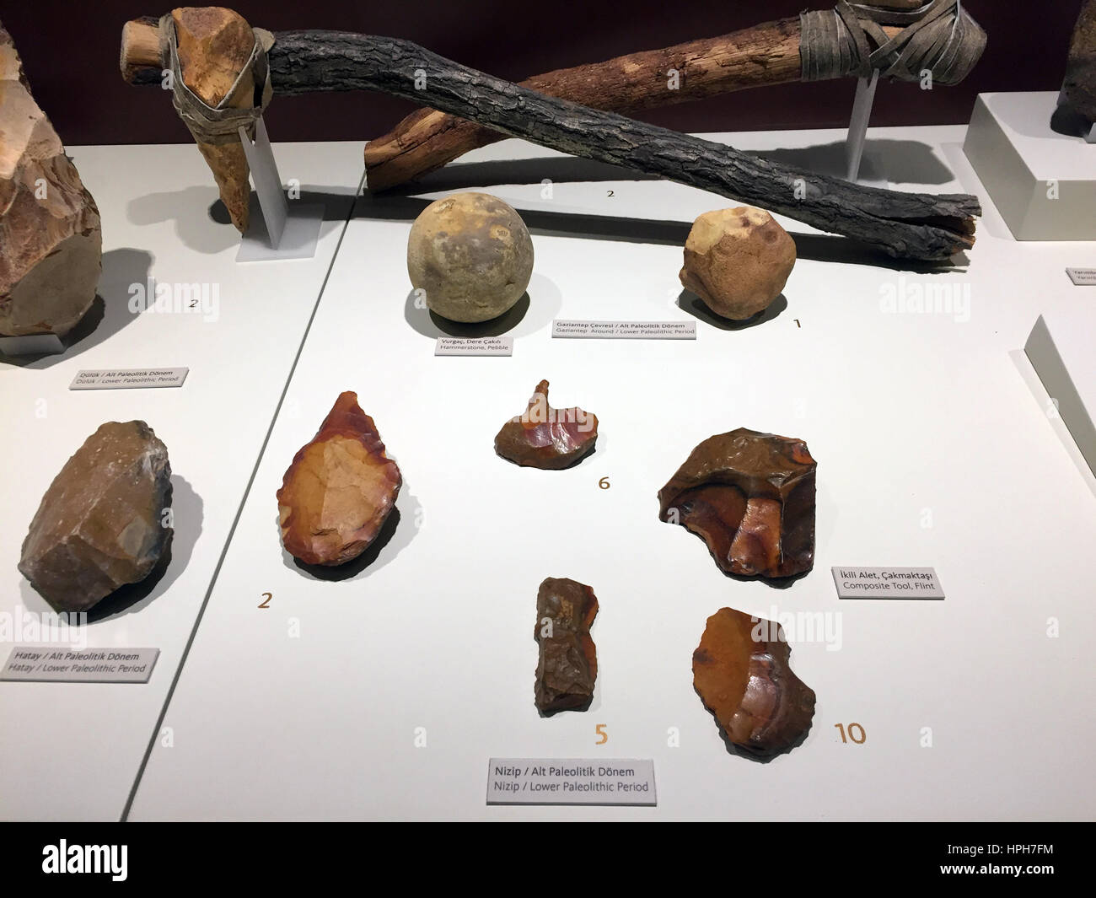
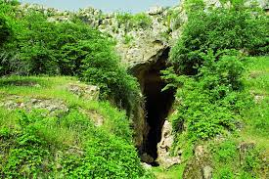
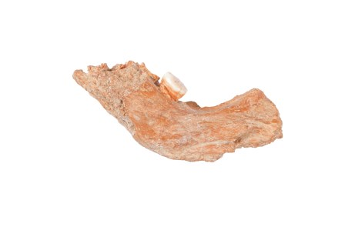
The Lower Paleolithic Period is dated from 1.5 million to 100 thousand years ago.
The tools belonged to Lower Paleolithic Period
Azikh Cave
A bone which belonged to azikhanthrop

Slide 5
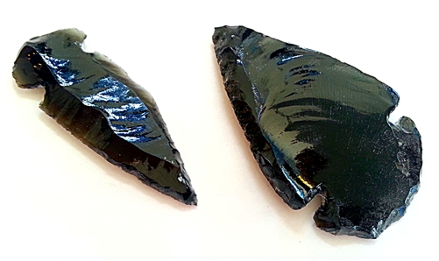
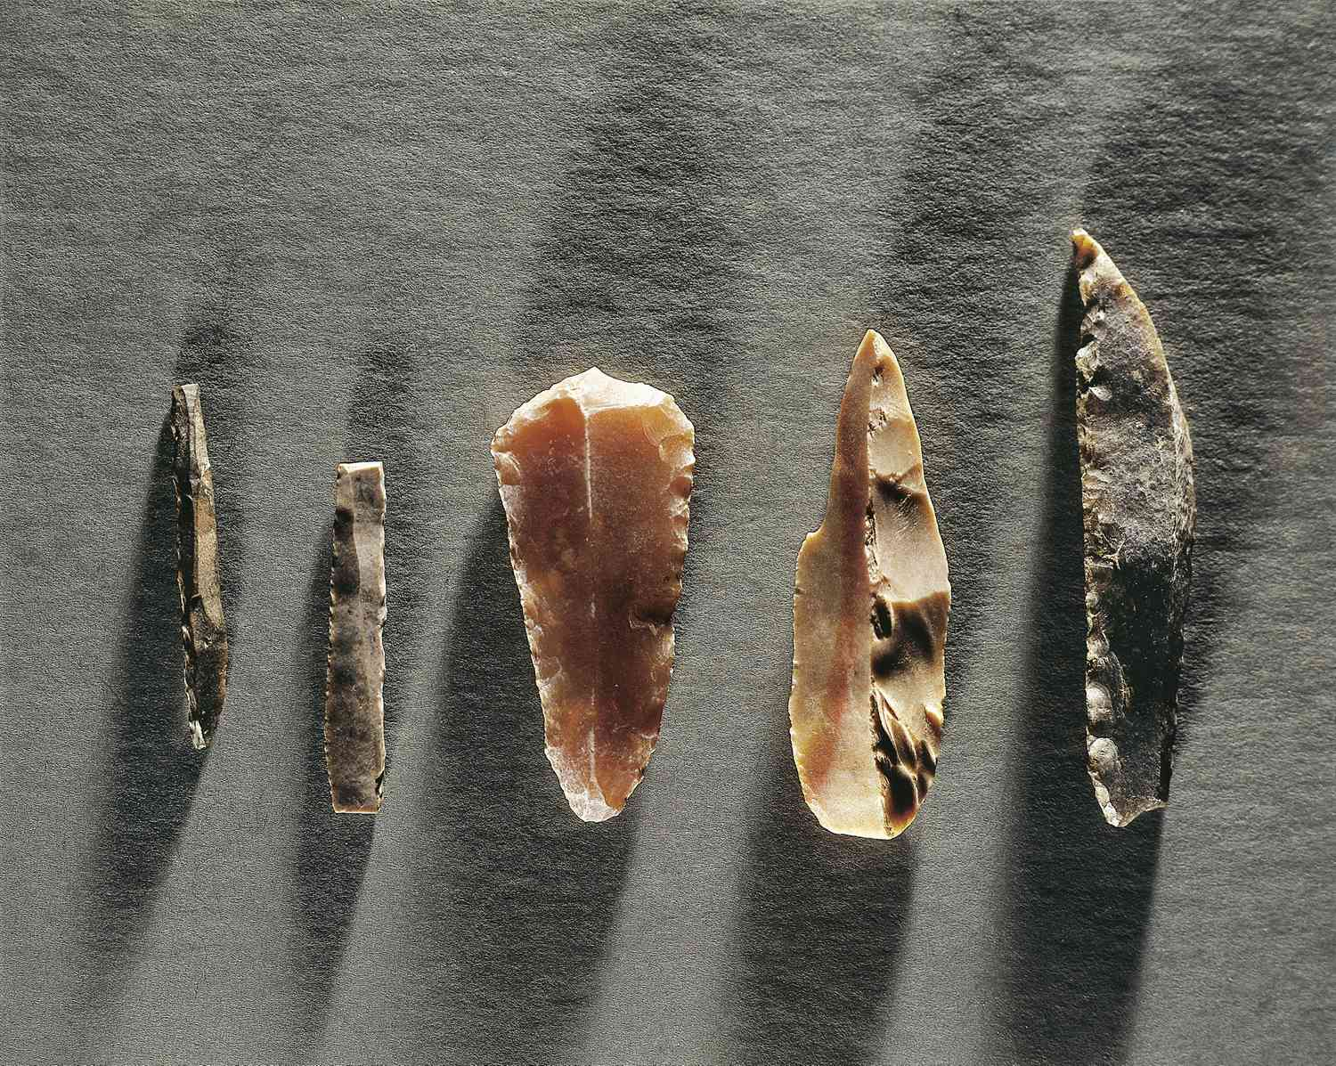
The Middle Paleolithic Period(100-40 thousand years ago)
Tools manufactured by flint and obsidian:

Slide 6
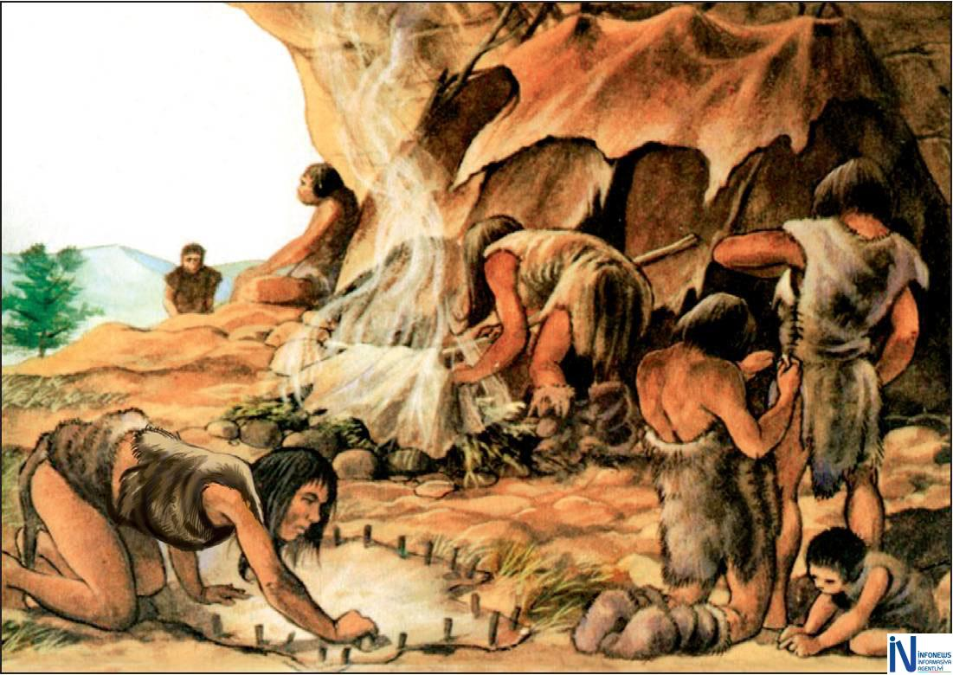
The Upper Paleolithic Period(40-12 thousand years ago)
In this period modern humans-Homo Sapiens were appeared.
Also in this period matriarchy was exited.

Slide 7
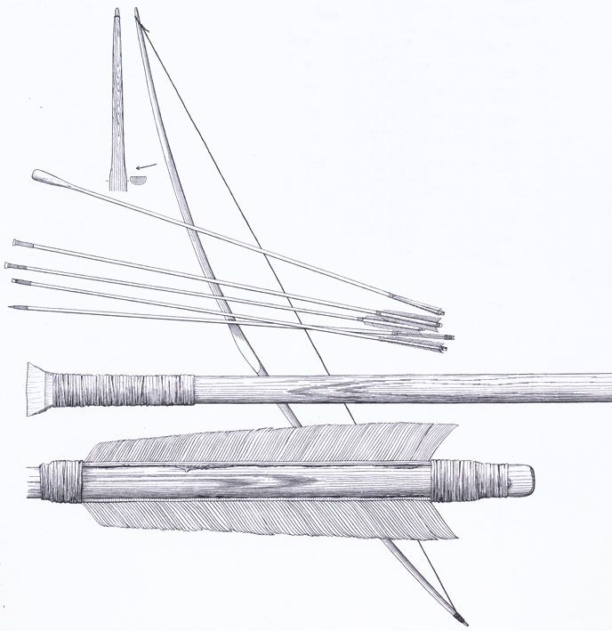
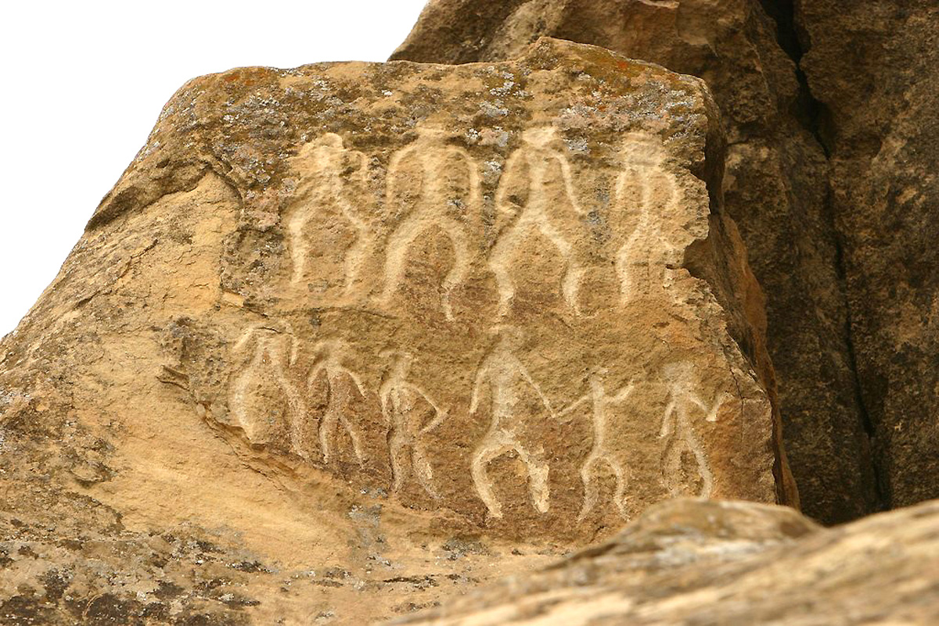
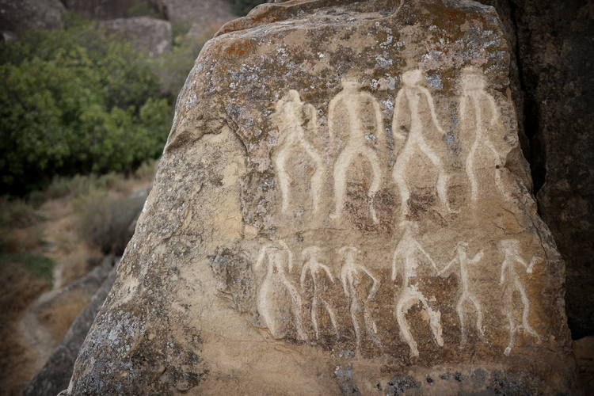
The Mesolithic Period(12th-8th millennium BC)
Bows which were found in Mesolithic Period
Drawings in Gobustan cave

Slide 8
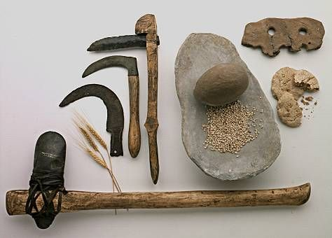
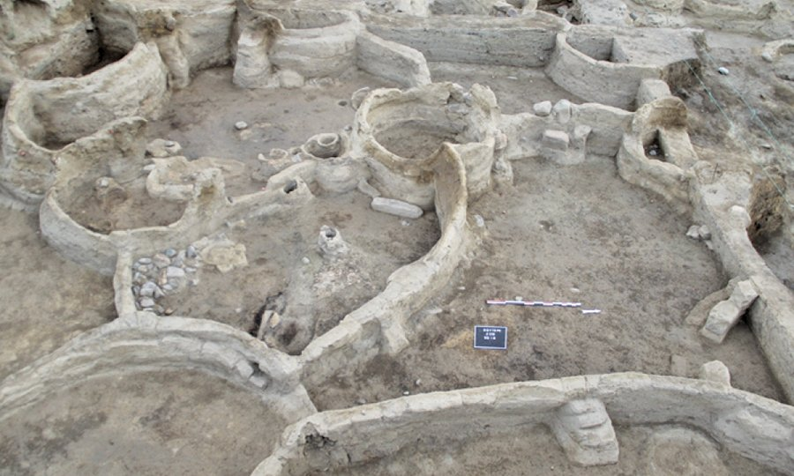
The Neolithic Period( 7th-6th millennium BC) People in this time made some tools by trough-shaped stones. Also sedentary life and agriculture spread in this period. In Neolithic Period cultivation and domestication were appeared.

Slide 9
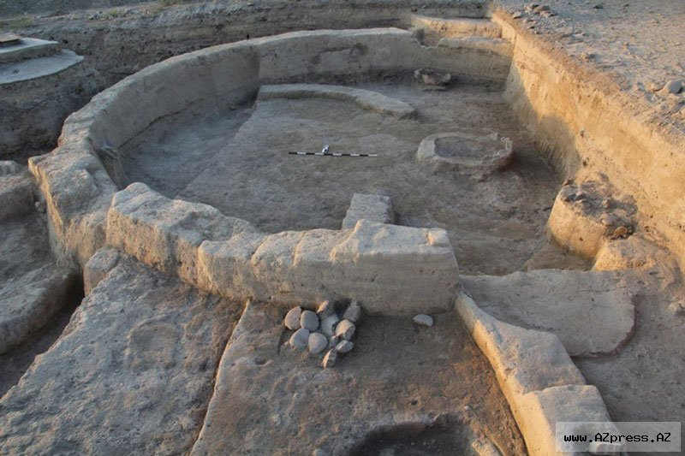
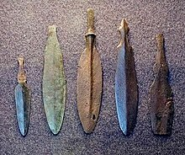
The Eneolithic Period(6th-4th millennium BC) In this time artificial irrigations were discovered in Shahtepe People become familiarized with metal-copper in this time.
Tools made by cold forging
Living place in Eneolithic period

Slide 10
Social divisions of labour
The first division of labour-livestocks seperated from crop cultivation;
The second social division of labour-handicrafts separated from agriculture;
The third division of labour-merchants separated from others.

Slide 11
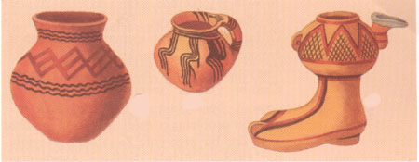
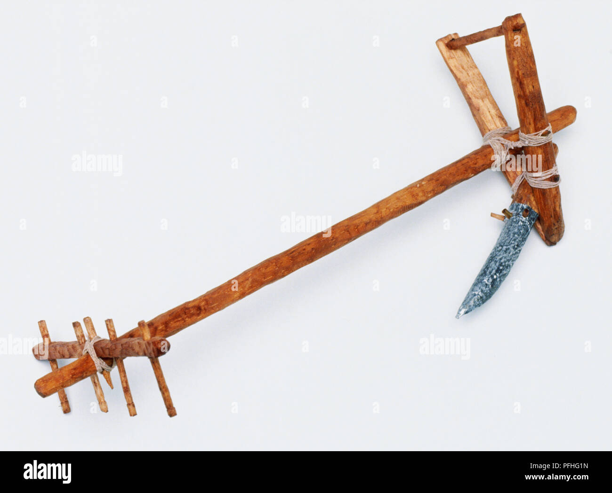
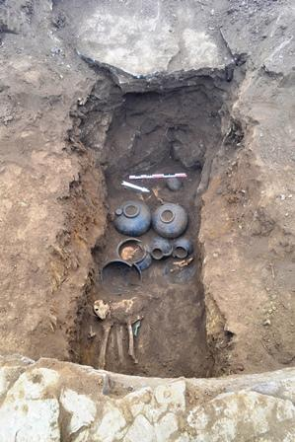
The Early Bronze Age(from the 2th part of 4th millennium BC to the end of 3th millennium BC)
Tool that used for plough – based cultivation
Pots belonged the Early Bronze Age
Mounds belonged to the Early Bronze Age

Slide 12
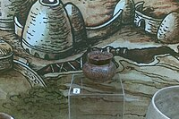
The Middle Bronze Age (From the end of 3th millennium BC to the beginning of 2th millennium BC
3500 years ago the first formation of urban culture in Nakchivan-Kultepe 2th

Slide 13
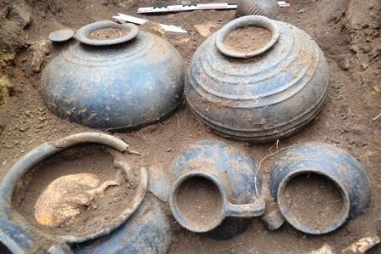
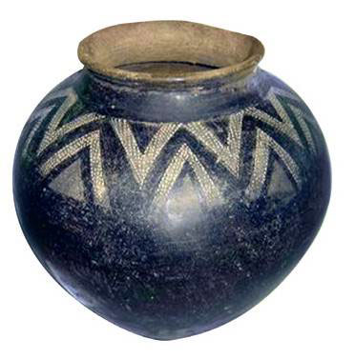
The Late Bronze-Early Iron Age(14th-7th centuries BC)
The mound that belonged to the Late Bronze-Early Iron Age

Slide 14
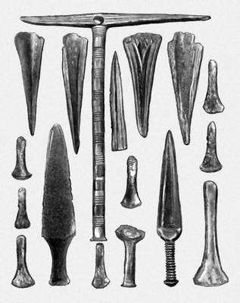
Creation of iron
By the end of 2nd millennium BC,iron was invented.Because of this invention iron metallurgy and metalworking were developed.

